Slide 1
Flask Part 1
Module 20
Notes:
Flask is a micro-framework for deploying web applications. Flask is written in python and uses python libraries to create web applications and APIs.

Slide 2
Module Overview
Contents
What is Flask?
HTTP Methods
Routes
Testing with Postman
Dynamic routes
Returning HTML
url_for()

Slide 3
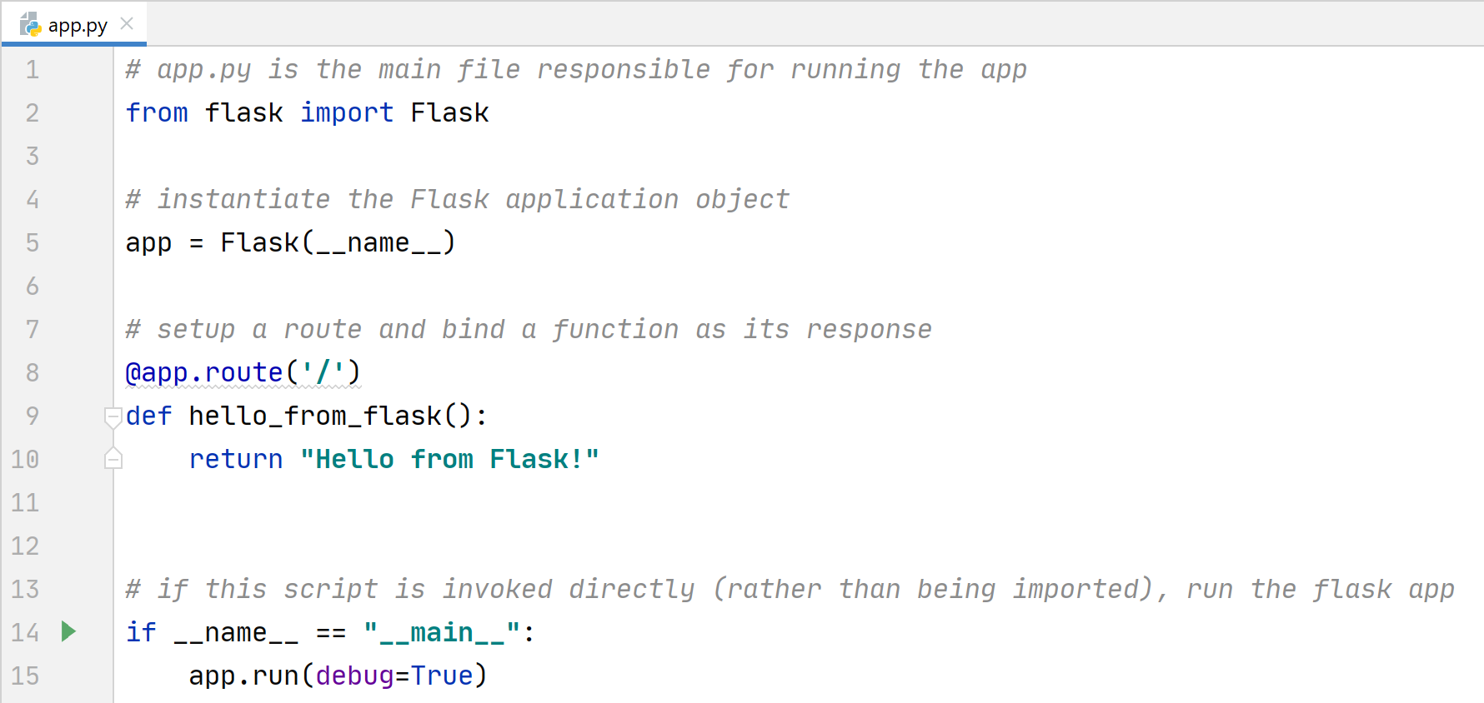
What is Flask?
Flask is a micro-framework for creating Python web applications and APIs
Flask is written in python and uses python libraries
A simple Flask Application:

Slide 4
HTTP Methods
The common HTTP request methods and their meaning:
HTTP Method | Action
GET | SELECT / READ
POST | INSERT / ADD
PUT | UPDATE / MODIFY
DELETE | DELETE

Slide 5
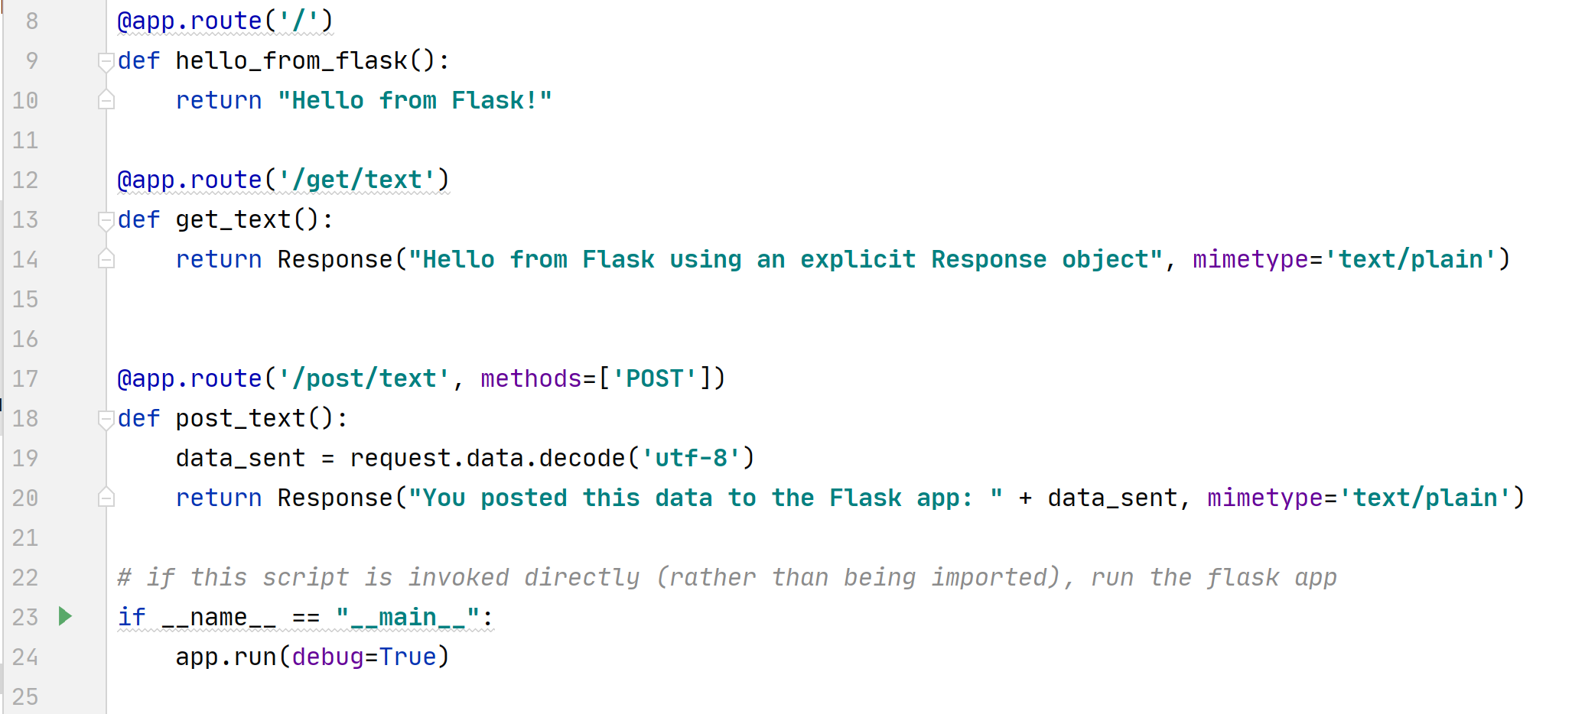
Route Examples:
Notes:
Routes are very important in flask, they provide the URL endpoint for your different pages as well as passing variables/data to your code. This data may be persisted in a data store or used within your front-end HTML.
For a web app to navigate the user to the right page for each URL, it needs to be configured to do so. This is done using the @app.route decorator.
The route decorator allows us to assign our function URLs easily.
If no methods attribute is specified within the @app.route decorator, GET is the default.
Above, there are two new routes defined: one for ‘/get/text’ and one for ‘/post/text’.
The first will match to an incoming HTTP GET request. The second will only match to an incoming HTTP POST request.

Slide 6
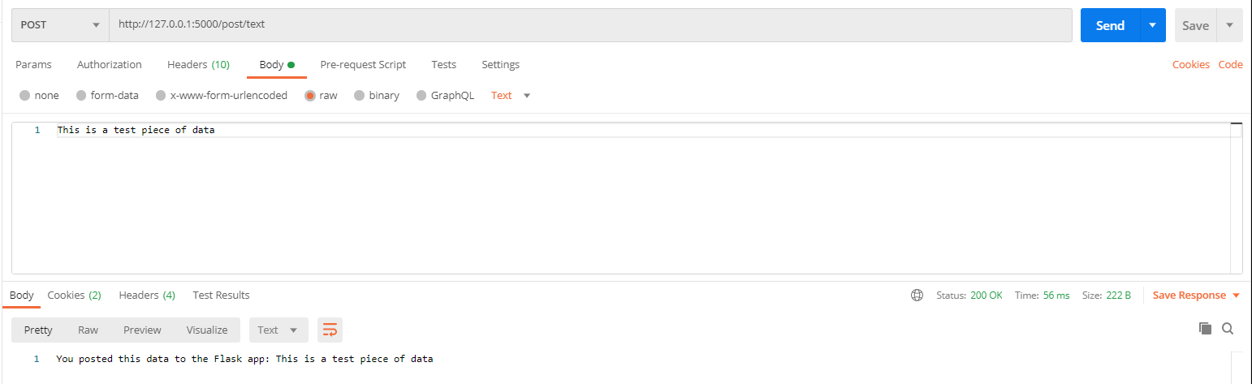
Testing with Postman
Notes:
To test the HTTP POST request we will need to use a tool as the browser, by default, sends GET requests.
To post some data in our request within the body section select raw and type in your test text.

Slide 7
Instructor Walkthrough
Create a simple flask application
Test it with Postman
Notes:
Your instructor will walk you through creating a simple flask application and testing it with Postman

Slide 8

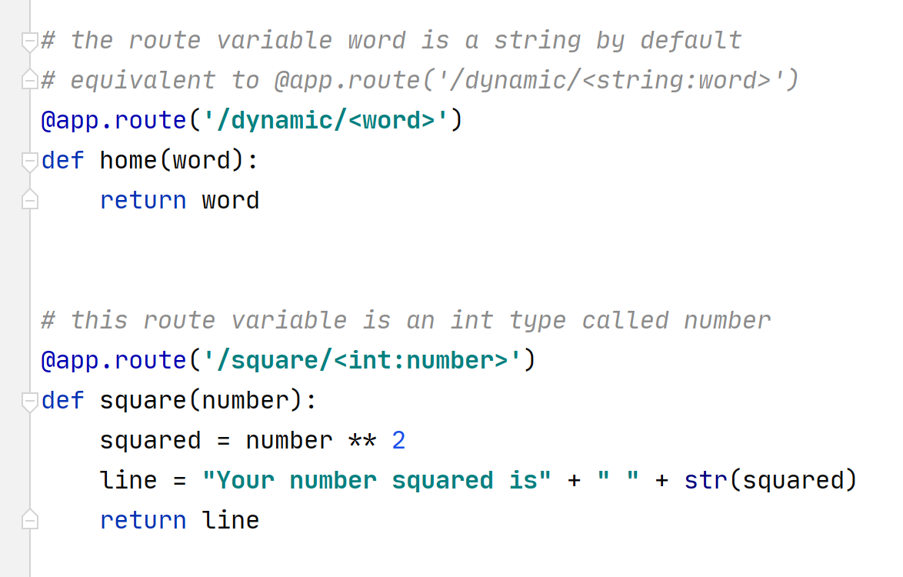
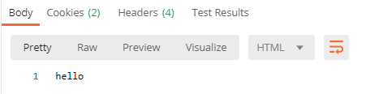

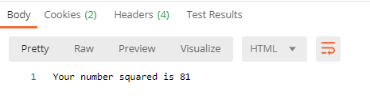
Dynamic routes

Slide 9
Activity:
Add a dynamic route to your Flask application to include a name variable that returns the response “Hello “ + name

Slide 10
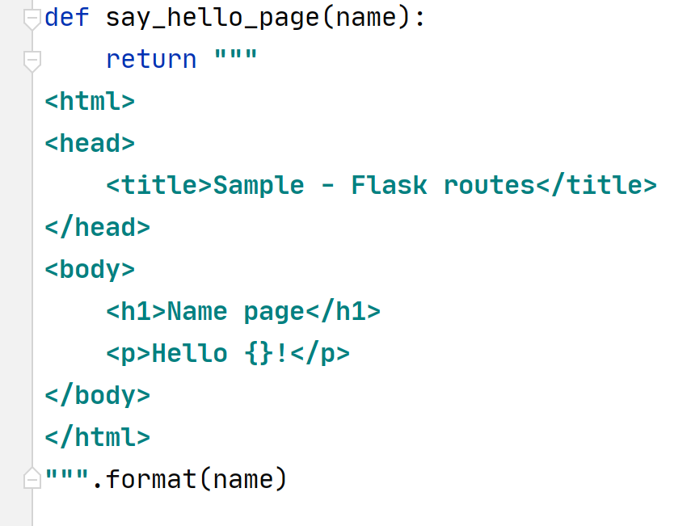
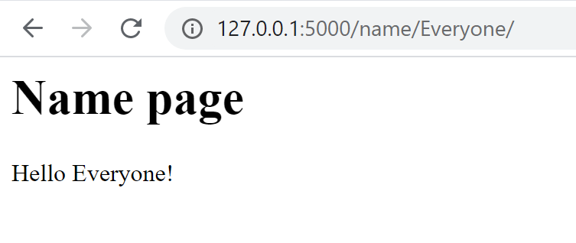
Instructor Walkthrough
Create a route to return an HTML page to display a hello message
Notes:
Your instructor will walk you through creating a route that returns an HTML page to display a hello message

Slide 11
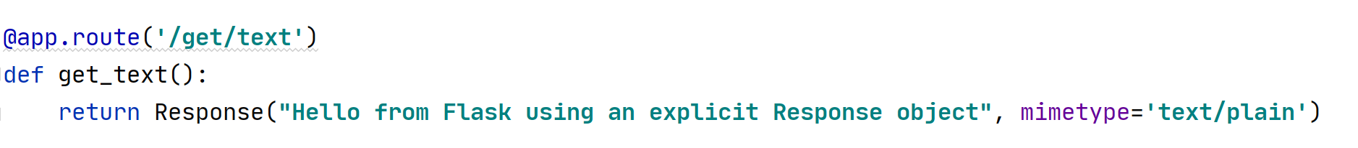
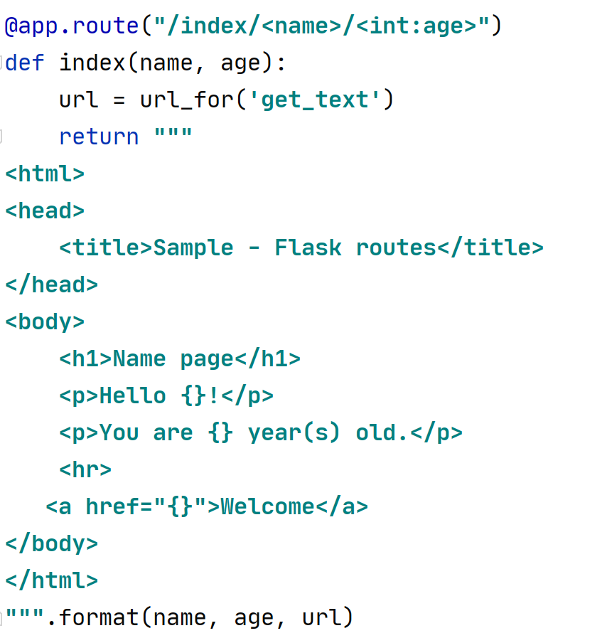
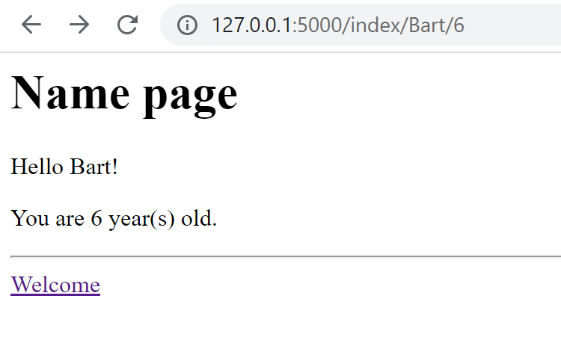
url_for() method
Notes:
Flask has a built-in function called url_for()
It enables you to create anchor tags and links to specific route functions for redirection to other routes within the application
Import the function from flask:
from flask import url_for
Pass the name of one of your route functions as the parameter to the url_for() function

Slide 12
Activity:
Add a route to your Flask application for an About Page and include a link to another route within the html of the page

Slide 13
Any questions?

